Slide 1

ECE 530 Cloud Computing
Ioannis Papapanagiotou
Data Pipeline without Messaging System

Slide 2
Messages in the Cloud
Messaging deals with sending data over internet to scale applications.
It is stateless i.e. does not store data.
It is used to synchronize stateful applications.
Messaging carries the state but itself is stateless.

Slide 3
Messaging Systems/Broker
Message broker is an intermediary program module that translates a message from the formal messaging protocol of the sender to the formal messaging protocol of the receiver. Examples:
Apache Kafka
Apache ActiveMQ
RabbitMQ
Celery Task Queue etc.
Messaging is an important piece of infrastructure for moving data between systems.
To see why, let’s look at a data pipeline without a messaging system.
Notes:
Message brokers are elements in telecommunication networks where software applications communicate by exchanging formally-defined messages. Message brokers are a building block of Message oriented middleware.

Slide 4

Data Pipeline – no Messaging System
This system starts with Hadoop for storage and data processing. Hadoop isn’t very useful without data so the first stage in using Hadoop is getting data in.
So far, not a big deal.
Unfortunately, in the real world data exists on many systems in parallel, all of which need to interact with Hadoop and with each other.

Slide 5
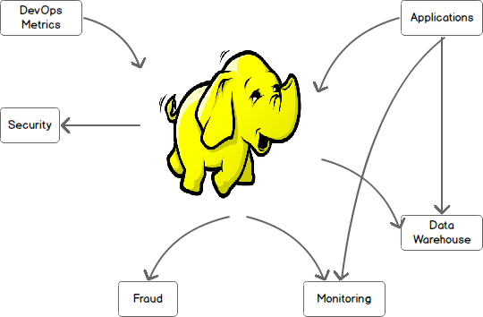
Data Pipeline - no Messaging System
The situation quickly becomes more complex, ending with a system where multiple data systems are talking to one another over many channels.
Each of these channels requires their own custom protocols and communication methods and moving data between these systems becomes a full-time job for a team of developers.

Slide 6
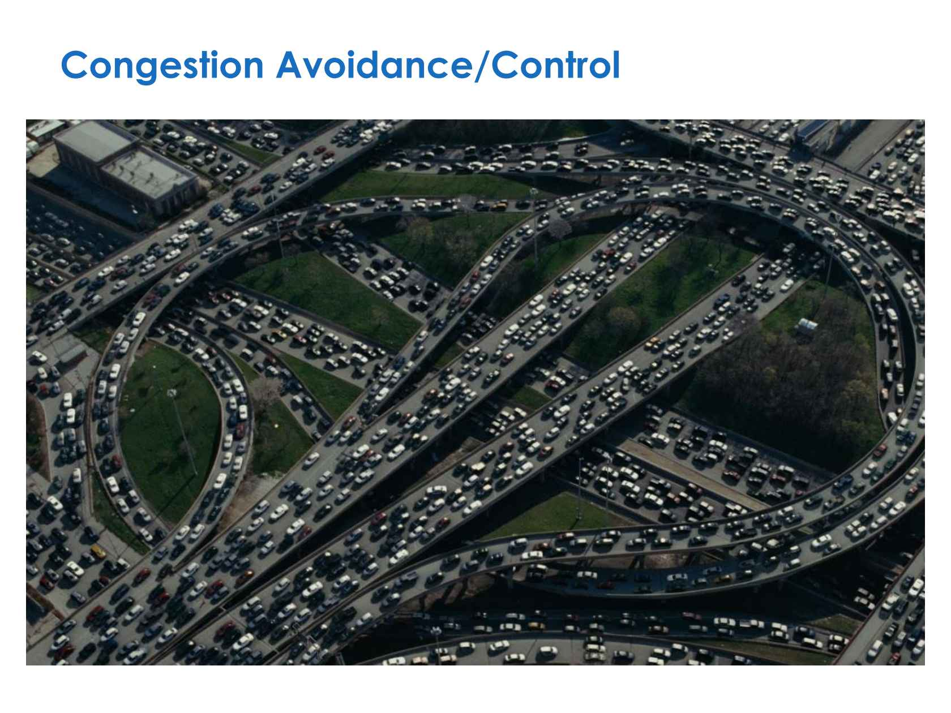
Data Pipeline - no Messaging System

